Slide 1

Hi..! Nice to meet you
I'm Hafiza Sidra

Slide 2
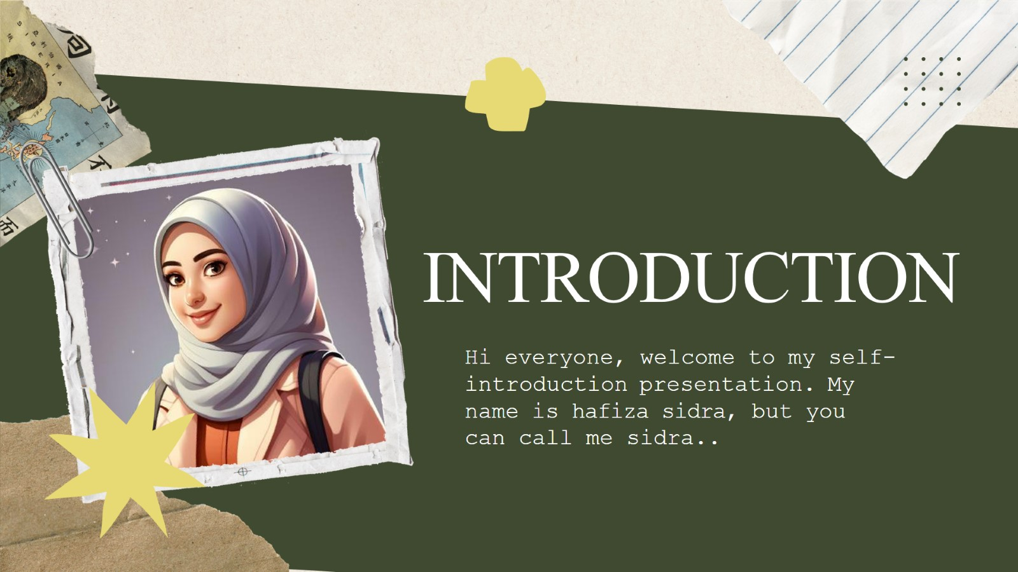
INTRODUCTION

Slide 3
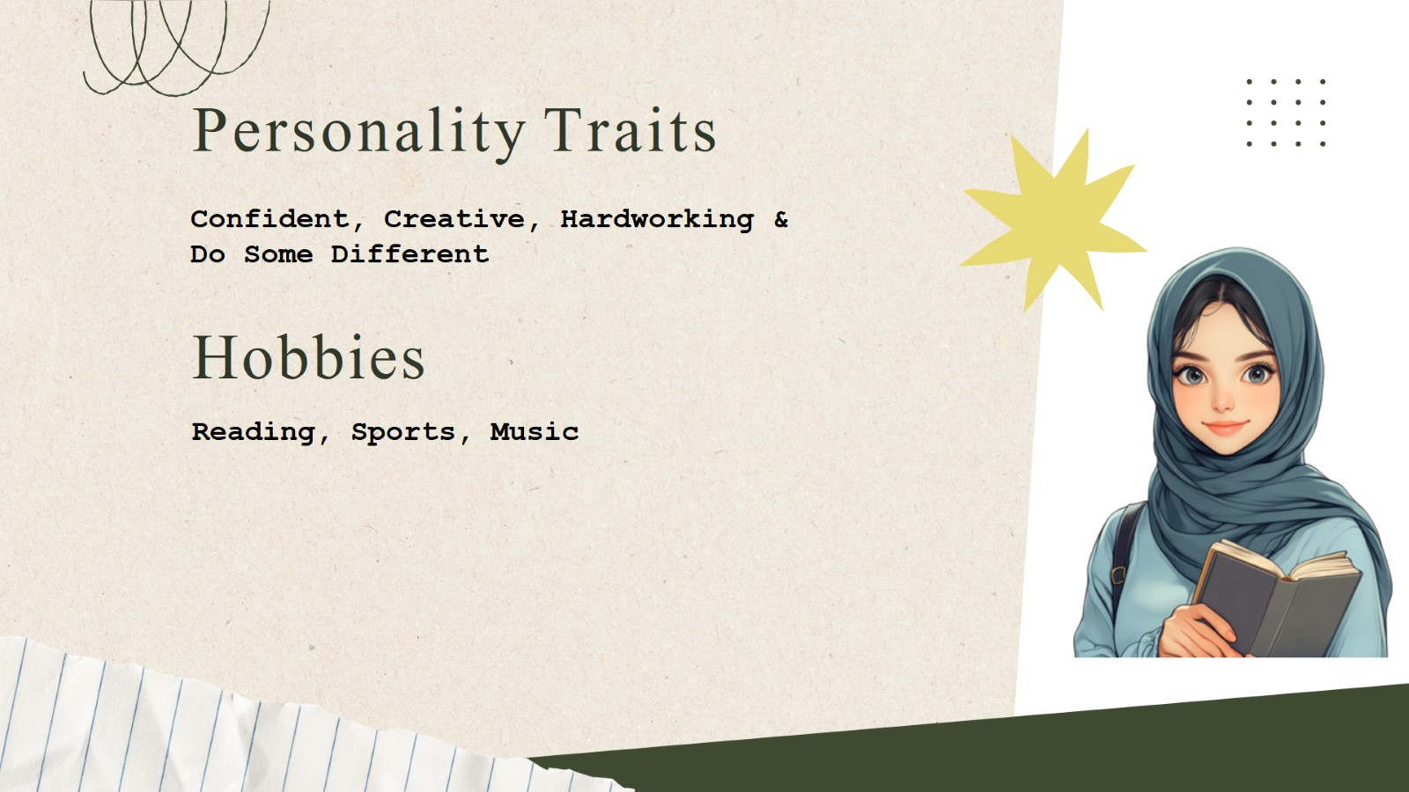
Personality Traits

Slide 4
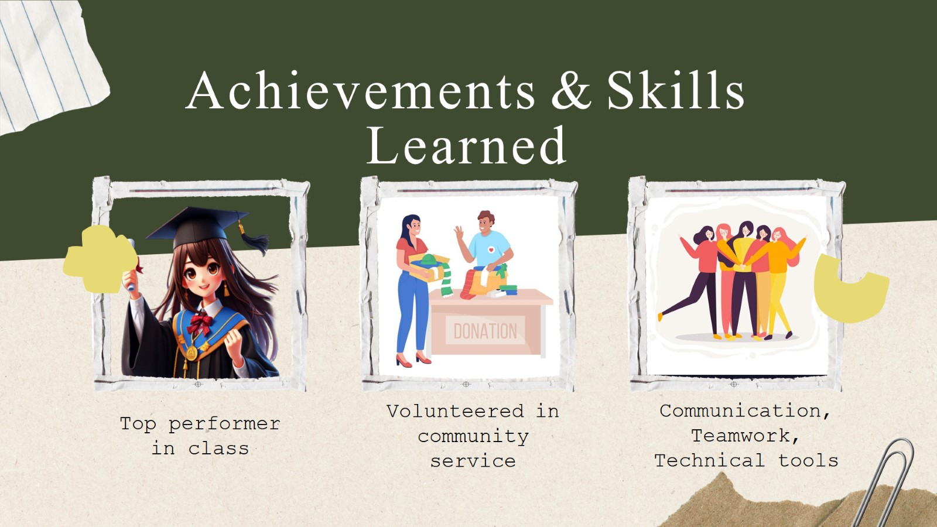
Achievements & Skills Learned

Slide 5

Strengths, Weaknesses & Future Goals

Slide 6
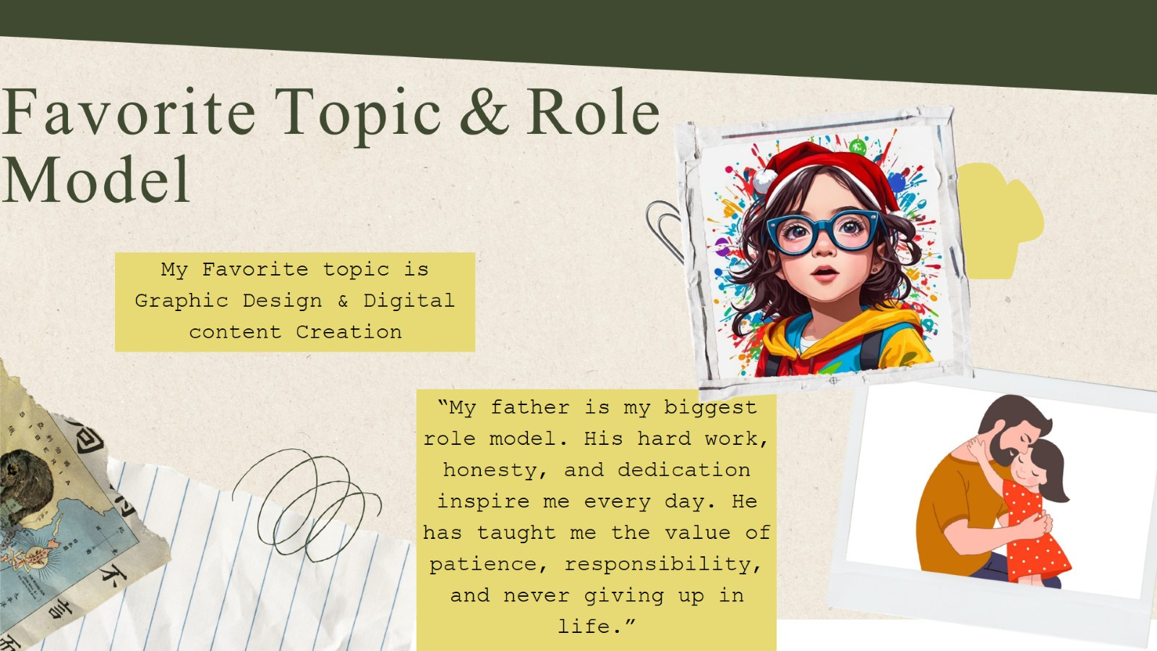
Favorite Topic & Role Model

Slide 7


